Slide 1
Unit VI
IO Management and Disk Scheduling
And
File Management

Slide 2
Contents
File organization
File directories
Record blocking
Secondary storage management
I/O devices
i/O buffering
Disk Scheduling

Slide 3
File Management
File management system consists of system utility programs that run as privileged applications.
Input to applications is by means of a file.
Output is saved in a file for long-term storage.
At the very least, a file management system needs special services from OS, at the most the FMS is considered part of the OS

Slide 4
File System Properties
Long-term existence: on secondary storage device
Sharable between processes: by names n associated access permissions
Structure: have internal structure, can be organized into hierarchical or more complex structure

Slide 5
File Operations
Acts as a means to store data n have collection of functions that can be performed on them.
Create
Delete
Open
Close
Read
Write

Slide 6
Terms Used with Files
Field
  Basic element of data
  Contains a single value
  Characterized by its length and data type
  Fixed/variable length
Record
  Collection of related fields treated as a unit
  Fixed/variable length
    Example: employee record

Slide 7
Terms Used with Files
File
  Collection of similar records
  Treated as a single entity by user/application
  Have file names
  Access control restriction applied at file level
  In some system , Access control restriction is applied at record/filed level also.
Database
  Collection of related data
  Relationships exist among elements
  Ex: Student database

Slide 8
Typical Operations
Retrieve_All : displaying summery; similar to sequential processing
Retrieve_One:Intereactive,transaction oriented appl.
Retrieve_Next: Intereactive appl.for searching/filling any field
Retrieve_Previous:Similar to Retrieve_Next:
Insert_One:
Delete_One :
Update_One :
Retrieve_Few :

Slide 9
File Management Systems
Set of system softwares that provides services to users and applications in the use of files.
The way a user of application may access files
Programmer does not need to develop file management software

Slide 10
Objectives of File Management System
Meet the data management needs and requirements of the user
Guarantee that the data in the file are valid
Optimize performance (System-Throughput, User-response time)
Provide I/O support for a variety of storage device types
Minimize or eliminate the potential for lost or destroyed data
Provide a standardized set of I/O interface routines to use processes
Provide I/O support for multiple users

Slide 11
Minimal Set of Requirements for interactive & general purpose system
Each user should be able to create, delete, read, write and modify files
Each user may have controlled access to other users’ files
Each user may control what type of accesses are allowed to the users’ files
Each user should be able to restructure the user’s files in a form appropriate to the problem
Each user should be able to move data between files
Each user should be able to back up and recover the user’s files in case of damage
Each user should be able to access the user’s files by using symbolic names

Slide 12
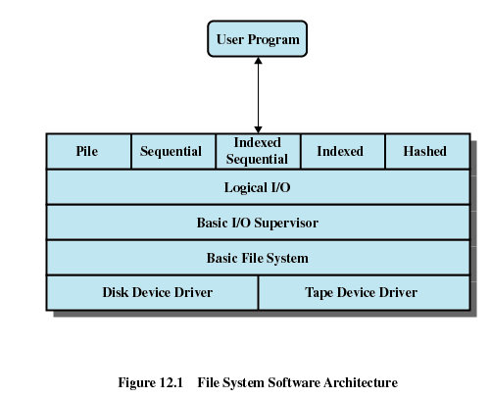

Slide 13
Device Drivers
Lowest level
Communicates directly with peripheral devices/channels
Responsible for starting I/O operations on a device &Processing the completion of an I/O request
Typical devices controlled are disk & tape drives.
Usually considered as part of OS

Slide 14
Basic File System
Basic file system/Physical I/O
Primary interface with the environment outside of computer
Deals with exchanging blocks of data with tape/disk system
Concerned with the placement of blocks on secondary storage
Concerned with buffering blocks in main memory
Considered as part of OS

Slide 15
Basic I/O Supervisor
Responsible for file I/O initiation and termination
Control structures are maintained that deal with
  Device I/O,
  Scheduling,
  File status
Concerned with selection of the device on which file I/O is to be performed
Concerned with scheduling access to optimize performance
Part of the operating system

Slide 16
Logical I/O
Enables users and applications to access records
Basic file system was dealing with block n it deals with records
Provides general-purpose record I/O capability
Maintains basic data about file

Slide 17
Access Method
Closest to the user
Provides a standard interface between applications and the file systems and devices that hold the data
Reflect different file structures
Access method varies depending on the ways to access and process data for the device.

Slide 18
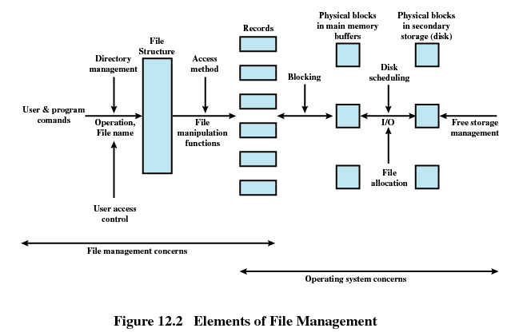
File Management Functions

Slide 19
File Management Functions
Identify and locate a selected file
Use a directory to describe the location of all files plus their attributes
On a shared system describe user access control
Blocking for access to files
Allocate files to free blocks
Manage free storage for available blocks

Slide 20
Contents
File Management Concept
File sharing
File organization
File directories
Record blocking
i/O buffering
Disk Scheduling

Slide 21
File Directories
Contains information about files
  Attributes
  Location
  Ownership
Directory itself is a file owned by the operating system
Provides mapping between file names and the files themselves

Slide 22
Directory Elements: Basic Information
File Name
  Name as chosen by creator (user or program).
  Must be unique within a specific directory.
File type:text,binary
File Organisation
  For systems that support different organizations
Notes:
From the user’s point of view, the directory provides a mapping between file names, known to users and applications, and the files themselves.

Slide 23
Directory Elements: Address Information
Volume
  Indicates device on which file is stored
Starting Address starting physical address on secondary storage
Size Used
  Current size of the file in bytes, words, or blocks
Size Allocated
  The maximum size of the file

Slide 24
Directory Elements: Access Control Information
Owner
  The owner may be able to grant/deny access to other users and to change these privileges.
Access Information
  May include the user’s name and password for each authorized user.
Permitted Actions
  Controls reading, writing, executing, transmitting over a network

Slide 25
Directory Elements: Usage Information
Date Created
Identity of Creator
Date Last Read Access
Identity of Last Reader
Date Last Modified
Identity of Last Modifier
Date of Last Backup
Current Usage
  Current activity, locks, etc

Slide 26
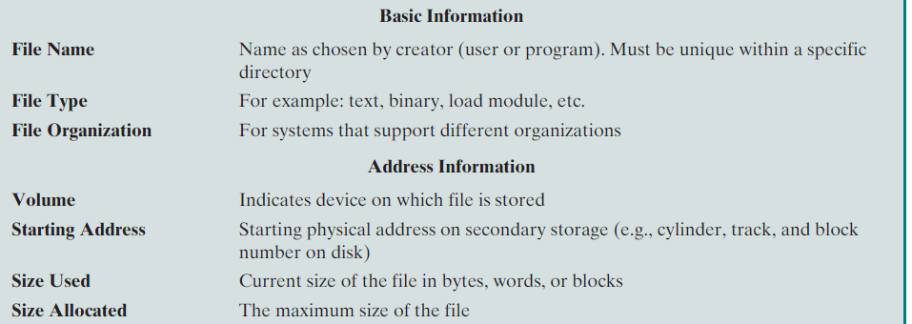

Slide 27
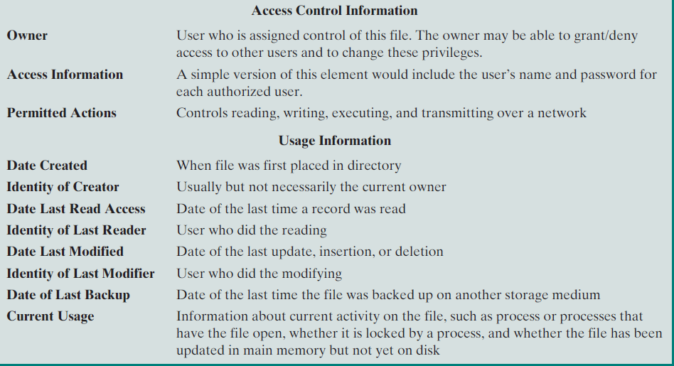

Slide 28
Operations Performed on a Directory
A directory system should support a number of operations including:
  Search
  Create files
  Deleting files
  Listing directory
  Updating directory
Notes:
NB the simple list will not easily support these operations.
Search: When a user or application references a file, the directory must be searched to find the entry corresponding to that file.
Create file: When a new file is created, an entry must be added to the directory.
Delete file: When a file is deleted, an entry must be removed from the directory.
List directory: All or a portion of the directory may be requested. Generally, this request is made by a user and results in a listing of all files owned by that user, plus some of the attributes of each file
Update directory: Because some file attributes are stored in the directory, a change in one of these attributes requires a change in the corresponding directory entry.

Slide 29
Directory Organizations
Simple
Two level scheme
Hierarchical or tree structured

Slide 30
Simple Structure for a Directory
List of entries, one for each file
Sequential file with the name of the file serving as the key
Provides no help in organizing the files
Forces user to be careful not to use the same name for two different files
Problems
  Flat organization
    No logical grouping, no access control
  Two files cannot have the same name
    Serious concern on shared user systems

Slide 31
Two-level Scheme for a Directory
One directory for each user and a master directory
Master directory contains entry for each user
  Provides address and access control information
Each user directory is a simple list of files for that user
File name need to be unique only within a user directory
System can easily enforce access restriction on directories
Still provides no help in structuring collections of files

Slide 32
Two-level Scheme for a Directory
Entry for each user: address, access control
Master directory
User directory
User directory
List of file
For user
User directory

Slide 33
Hierarchical, or Tree-Structured Directory
Master directory with user directories underneath it
Each user directory may have subdirectories and files as entries
Files can be located by following a path from the root, or master, directory down various branches
  This is the pathname for the file
Can have several files with the same file name as long as they have unique path names
Current directory is the working directory
Files are referenced relative to the working directory

Slide 34
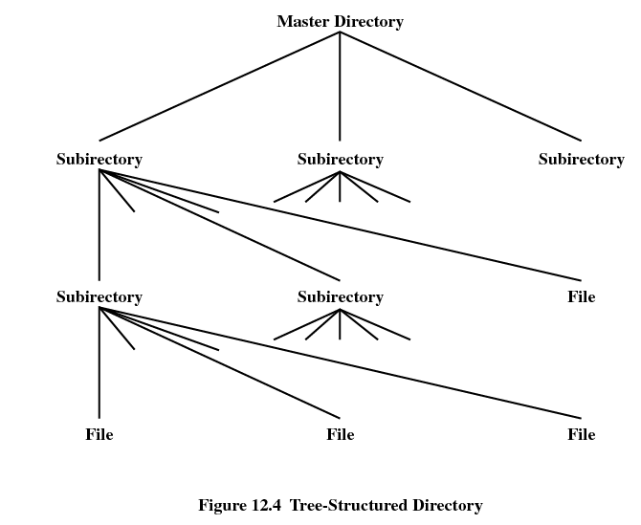

Slide 35
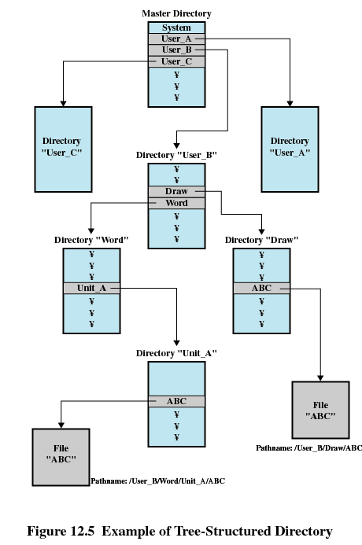

Slide 36
Contents
File Management Concept
File sharing
File organization
File directories
Record blocking
I/O buffering
Disk Scheduling

Slide 37
File Sharing
In multiuser system, allow files to be shared among users
Two issues
  Access rights
  Management of simultaneous access

Slide 38
Access Rights
None
  User may not know of the existence of the file
  User is not allowed to read the user directory that includes the file
Knowledge
  User can only determine that the file exists and who its owner is

Slide 39
Access Rights
Execution
  The user can load and execute a program but cannot copy it
Reading
  The user can read the file for any purpose, including copying and execution
Appending
  The user can add data to the file at the end but cannot modify or delete any of the file’s contents

Slide 40
Access Rights
Updating
  The user can modify, deleted, and add to the file’s data. This includes creating the file, rewriting it, and removing all or part of the data
Changing protection
  User can change access rights granted to other users
Deletion
  User can delete the file

Slide 41
Access Rights
Owners
  Has all rights previously listed
  May grant rights to others using the following classes of users
    Specific user:Individual user
    User groups:a set of users
    All : All users for public files

Slide 42
Simultaneous Access
User may lock entire file when it is to be updated
User may lock the individual records during the update
Mutual exclusion and deadlock are issues for shared access

Slide 43
Contents
File Management Concept
File sharing
File organization
File directories
Record blocking
i/O buffering
Disk Scheduling

Slide 44
Record Blocking
Records are the logical unit of access of a structured file
But blocks are the unit for I/O with secondary storage
To perform I/O records must be organized as blocks.
Issues related with block
  Should blocks be fixed or variable length?
    Most system supports fixed size blocks which simplifies I/O, buffer allocation in main memory and organization of blocks on secondary storage device.
  What should be the relative size of block be compared to the average record size.

Slide 45
Record Blocking
  Given the size of block ,there are Three methods of record blocking
  1. Fixed Blocking
  2. Variable Blocking: Spanned
  3. Variable Blocking Unspanned

Slide 46
Fixed Blocking
Fixed-length records are used, and an integral number of records are stored in a block.
Unused space at the end of a block is internal fragmentation
It is common method for sequential files with fixed length records

Slide 47
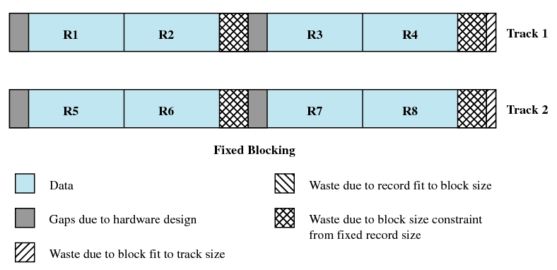
Fixed Blocking

Slide 48
Variable Length ,Spanned Blocking
Variable-length records are used and are packed into blocks with no unused space.
Some records may span multiple blocks
  Continuation is indicated by a pointer to the successor block
  It is efficient for storage and does not limit the size of records.
  It is difficult to implement .
  as record span two blocks require two I/O & files are difficult to update.

Slide 49
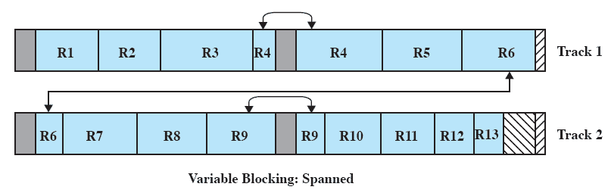
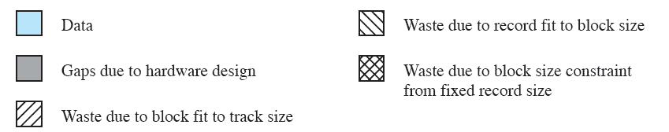
Variable Length ,Spanned Blocking

Slide 50
Variable Length ,Unspanned Blocking
Uses variable length records without spanning
Wasted space in most blocks because of the inability to use the remainder of a block if the next record is larger than the remaining unused space.
Results in wasted space & limits record size to the size of block.

Slide 51
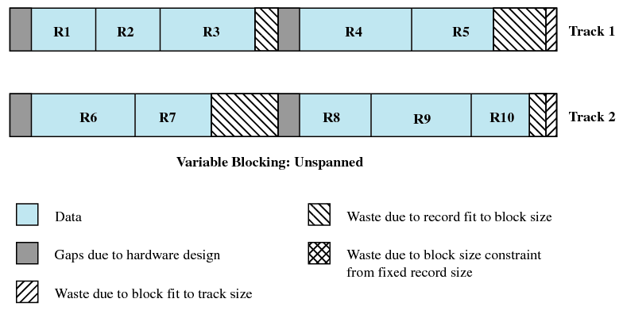
Variable Blocking Unspanned

Slide 52
Contents
File Management Concept
File sharing
File organization
File directories
Record blocking
I/O devices
Operating System design issues
I/O buffering
Disk Scheduling

Slide 53
Introduction
Humans interact with machines by providing
information through IO devices.
Many on-line services are availed through use of specialized devices like printers, keyboards etc.
Management of these devices can affect the throughput of a system.

Slide 54
Categories of I/O Devices
Communication with an IO device is required at the following levels:
  The need for a human to input information and output from a computer.
  The need for a device to input information and receive output from a computer.
  The need for computers to communicate over networks.

Slide 55
Categories of I/O Devices
Human readable/Interfacing
      Used to communicate with the user
      Ex:
        video display terminals
        keyboard
        mouse
        printer

Slide 56
Categories of I/O Devices
Machine readable/storage devices
      Used to communicate with electronic equipment
      Ex:
        Disk drives
        Tape drives
        Controllers
        Sensors
        Actuators
        USB keys

Slide 57
Categories of I/O Devices
Communication/transmission
      Used to communicate with remote devices
      Ex:
        digital line drivers
        Modems
        controllers

Slide 58
Differences in I/O Devices
Data Transfer Rate: may be difference of several orders of magnitude between the data transfer rates.
Application: the expected use of a device affects the software policies and priorities employed by an operating system
      disk used to store files must have file-management software
      disk used to store virtual memory pages needs special hardware to support it
      terminal used by system administrator or normal user
      may have different privilege levels

Slide 59
Differences in I/O Devices
Complexity of control: devices such as mice and keyboards require little control (being read-only devices), whereas bidirectional, mirrored disk drives are much more complex.
Unit of transfer
      data may be transferred as a stream of bytes for a terminal or in larger blocks for a disk
Data representation
      encoding schemes are used by different devices
Error conditions
      The error of nature ,the way in which they are reported, their consequences ,available response differs.

Slide 60
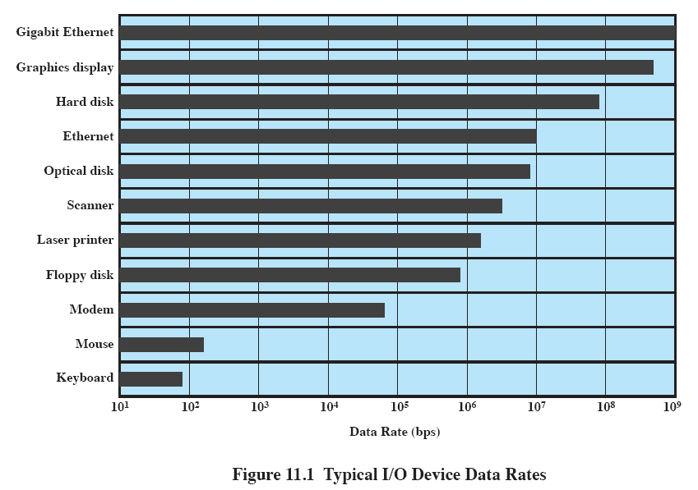
I/O Device Data Rates

Slide 61
Contents
File Management Concept
File sharing
File organization
File directories
Record blocking
I/O devices
Operating System design issues
I/O buffering
Disk Scheduling

Slide 62
Operating System Design Objectives
Efficiency & Generality
Efficiency is important as IO operations forms bottleneck in a computing system.
  I/O extremely slow compared to main memory/processor
  Use of multiprogramming allows for some processes to be waiting on I/O while another process executes.
  I/O cannot keep up with processor speed
  Swapping is used to bring in additional Ready processes which itself is an I/O operation

Slide 63
Operating System Design Objectives
Generality is an important issue
  Desirable to handle all I/O devices in a uniform manner.
  Means the way process view I/O devices and the way by which OS manages I/O devices & operations.
  How to achieve this?
  Use hierarchical, modular approach to the design of the I/o function.
  Hide most of the details of device I/O in lower-level routines so that user processes and upper levels see devices in general terms such as Read, Write, Open, and Close

Slide 64
Hierarchical design
A hierarchical philosophy leads to organizing an OS into layers.
Functions of operating system should be separated according to their complexity ,time scale & level of abstraction.
Each layer performs a related subset of the functions required of the operating system.
Each layer relies on the next lower layer to perform more primitive functions
It provides services to the next higher layer.
Changes in one layer should not require changes in other layers
At the lowest level of the I/O hierarchy are sections of code which must interact directly with hardware, and complete their activities in a few billionths of a second.

Slide 65
A Model of I/O Organization
Based on Type of device & application
User
Processes
User
Processes
User
Processes
Directory
Management
Logical
I/O
Comm.
Architecture
File
System
Physical
Organization
Device
I/O
Device
I/O
Device
I/O
Scheduling
& Control
Scheduling
& Control
Scheduling
& Control
Hardware
Hardware
Hardware
Local peripheral device
Communications port
File System

Slide 66
Contents
File Management Concept
File sharing
File organization
File directories
Record blocking
I/O buffering
Disk Scheduling

Slide 67
I/O Buffering
Scenario: a user process wants to read blocks of data from tape/disk, one at a time
  Each block = 512 bytes
  To be stored into virtual address 1000 to 1511
Simplest way?
  Execute I/O instruction and wait for data to become available
  Either busy wait, or process suspension on an interrupt.
Two Problems
  The process has to wait a long time before the completion of the operation due to the low speed of the tape device
  I/O interferes with the swapping mechanism in the operation system.
  1000-1511 must always be in memory during block transfer
    Even if OS wants, it cannot swap out a process completely

Slide 68
I/O Buffering
There is also a risk of single process deadlock!
  Process issues I/O command
  Suspended awaiting result
  Swapped out before I/O began
  Process is blocked waiting for I/O completion and I/O is blocked waiting for process be to be swapped back in!
How to avoid?
  User memory involved in I/O must be locked immediately before I/O request is issued, even though actual I/O operation may take place after some time

Slide 69
I/O Buffering
There is a speed mismatch between I/O devices and CPU. This leads to inefficiency in processes being completed.
To increase the efficiency, it may be convenient to perform input transfers in advance of requests being made and to perform output transfers some time after the request is made. This technique is known as buffering.
A buffer is a memory area that stores data while they are transferred b/n two devices or b/n a device & an application.

Slide 70
I/O Buffering
Reasons for buffering
  To cope with a speed mismatch b/n the producer & consumer of a data stream.
  Ex: File being received via modem for storage on the hard disk.
  Use of buffering is to adapt b/n devices that have different data transfer sizes.
  Ex: in computer networking buffers are used widely for fragmentation & reassembly of msgs.
  To support copy semantics for application I/O.
  Ex: Example of write () system call

Slide 71
I/O Buffering
Types of devices
  Block-oriented
      information is stored in fixed sized blocks
      transfers are made a block at a time
      used for disks and tapes
  Stream-oriented
      transfer information as a stream of bytes
      used for terminals, printers, communication ports, mouse, and most other devices that are not secondary storage

Slide 72
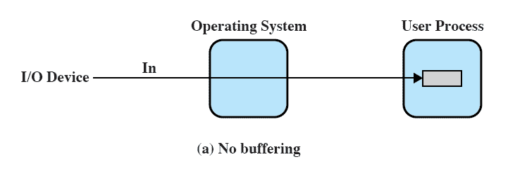
No Buffering

Slide 73
Single Buffer (input)
Operating system assigns a buffer in system portion of the main memory for an I/O request
Example in case of block-oriented devices
  Input transfers made to the system buffer
  When transfer is complete, process moves the block to user space
  Immediately requests another block
    Called reading ahead or anticipated input
    Fair enough assumption except for the “last” block
User process can now be processing the previous block while the next block is being read
OS can feel free to swap because I/O is taking place with system memory, not process memory
Vishal Kaushal

Slide 74
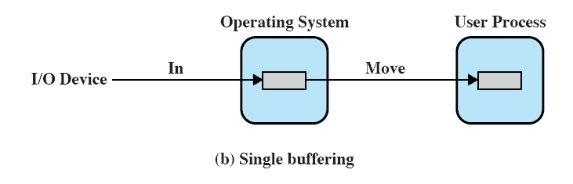
Single Buffer (input)
Vishal Kaushal

Slide 75
Single Buffer
Block-oriented
  user process can process one block of data while next block is read in
  swapping can occur since input is taking place in system memory, not user memory
  operating system keeps track of assignment of system buffers to user processes
  output is accomplished by the user process writing a block to the buffer and later actually written out

Slide 76
Single Buffer
Stream-oriented
  in a line- at- a time Fashion or a byte-at-a-time fashion.
  user input from a terminal is one line at a time with carriage return signaling the end of the line
  output to the terminal is one line at a time
  For eg. Scroll-mode terminals, line printer
  In case of byte-at-a-time ,each keystroke is important in sensor,controller.
  OS & user process follows producer-consumer model

Slide 77
Single Buffer (input)
C:Comutation Time b/w two requests
T
M
Without buffering: C+T
With buffering: max[C,T] + M
Vishal Kaushal

Slide 78
Single Buffer
Suppose that T is required to input one block
C is the computation time that intervenes b/n input requests.
Without buffering, the execution time per block is essentially T+C.
With a single buffer, the time is max[C, T] +M, Where M is the time required to move the data from the system buffer to user memory.
In most cases execution time per block is less with a single buffer compared to no buffer.

Slide 79
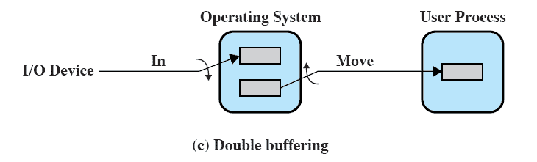
Double Buffer
Use two system buffers instead of one
A process can transfer data to or from one buffer while the operating system empties or fills the other buffer.
known as buffer swapping.

Slide 80
Double Buffer
For block-oriented transfer, we can roughly estimate the execution time as max[C,T].
In both cases(C<= T and C>T) an improvement over single buffering is achieved. Again, this improvement comes at the cost of increased complexity.
For stream-oriented input, there are two alternative modes of operation.
For line-at-a time I/O, the user process need not be suspended for input or output, unless the process runs ahead of the double buffers.
For byte-at-a time operation, the double buffer offers no particular advantage over a single buffer of twice the length.
  OS & user process follows producer-consumer model

Slide 81
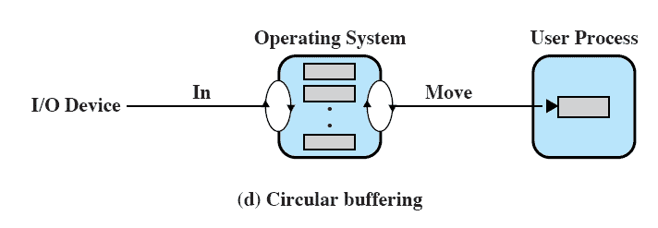
Circular Buffer
Double buffering may be inadequate if the process performs rapid bursts of I/O.
More than two buffers are used
Each individual buffer is one unit in a circular buffer
Used when I/O operation must keep up with process
  OS & user process follows producer-consumer model

Slide 82
Contents
File Management Concept
File sharing
File organization
File directories
Record blocking
I/O devices
Operating System design issues
I/O buffering
Disk Scheduling

Slide 83
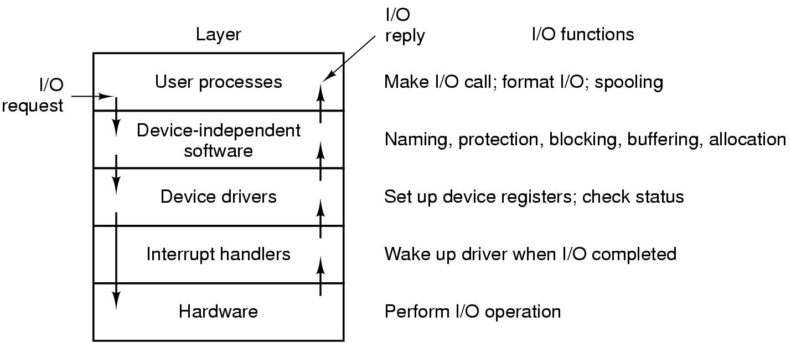
User-Space I/O Software
Layers of the I/O system and the main functions of each layer

Slide 84
Disk Structure
Disk drives are addressed as large 1-dimensional arrays of logical blocks, where the logical block is the smallest unit of transfer.
The 1-dimensional array of logical blocks is mapped into the sectors of the disk sequentially.
  Sector 0 is the first sector of the first track on the outermost cylinder.
  Mapping proceeds in order through that track, then the rest of the tracks in that cylinder, and then through the rest of the cylinders from outermost to innermost.
Lets understand track, sector and cylinder concept.

Slide 85
Disk Scheduling
Physical organization of data on disk
Track, sector
Seek time
Rotational delay or rotational latency
Access Time
Importance of disk scheduling
  Two cases of total time to read a file!!

Slide 86
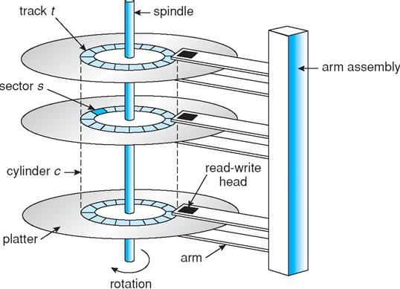
Physical Disk Structure

Slide 87
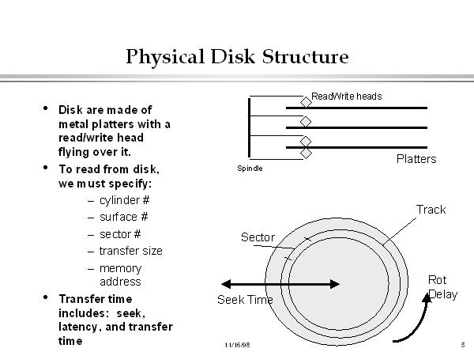
Physical Disk Structure

Slide 88
Disk Scheduling
Disk Performance Parameters:
To read or write, the disk head must be positioned at the desired track and at the beginning of the desired sector
Seek time
      time it takes to position the head at the desired track
Rotational delay or rotational latency
      time its takes until desired sector is rotated to line up with the head

Slide 89
Disk Scheduling
Disk Performance Parameters:
Access time
      sum of seek time and rotational delay
      the time it takes to get in position to read or write
Data transfer occurs as the sector moves under the head
Data transfer for an entire file is faster when the file is stored in the same cylinder and in adjacent sectors

Slide 90
Disk Scheduling Policies
Seek time is the reason for differences in performance
For a single disk there will be a number of I/O requests
If requests are selected randomly, we will get the worst possible performance

Slide 91
FCFS 3/FRAMES :15
4 FRAMS:9
LRU: 3 /F :12
4/F:7
OPTIMAL 3/F :9
4/F :8

Slide 92
Disk Scheduling Example

Slide 93
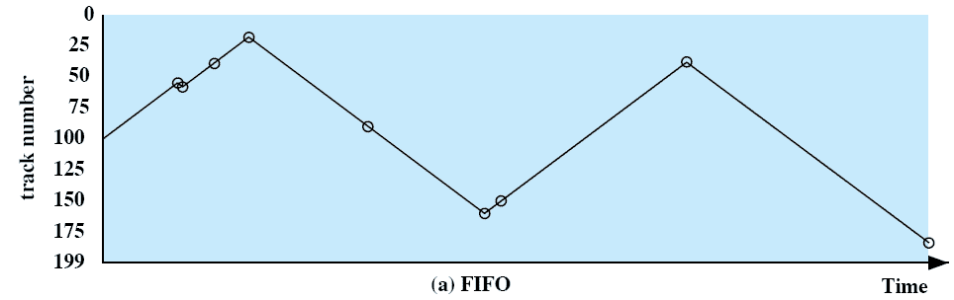
First-in, first-out (FIFO)
Process request sequentially
Fair to all processes
Approaches random scheduling in performance if there are many processes
Notes:
Movie icon jumps to animation at http://gaia.ecs.csus.edu/%7ezhangd/oscal/DiskApplet.html
The simplest form of scheduling is first-in-first-out (FIFO) scheduling, which processes items from the queue in sequential order.
This strategy has the advantage of being fair, because every request is honored and the requests are honored in the order received.
This figure illustrates the disk arm movement with FIFO.
This graph is generated directly from the data in Table 11.2a.
As can be seen, the disk accesses are in the same order as the requests were originally received.
With FIFO, if there are only a few processes that require access and if many of the requests are to clustered file sectors, then we can hope for good performance.
But, this technique will often approximate random scheduling in performance, if there are many processes competing for the disk.

Slide 94
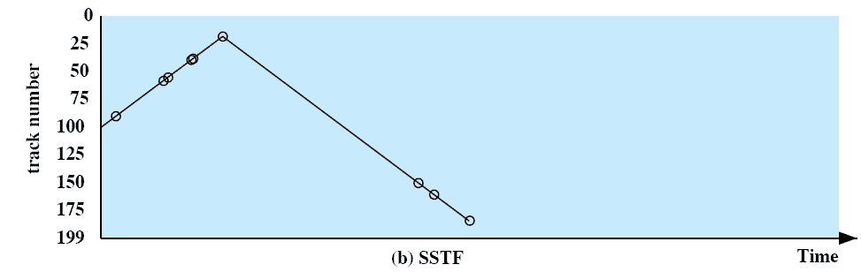
Shortest Service Time First (SSTF)
Select the disk I/O request that requires the least movement of the disk arm from its current position
Always choose the minimum seek time
Notes:
Select the disk I/O request that requires the least movement of the disk arm from its current position.
Thus, we always choose to incur the minimum seek time.
Always choosing the minimum seek time does not guarantee that the average seek time over a number of arm movements will be minimum.
However, this should provide better performance than FIFO.
Because the arm can move in two directions, a random tie-breaking algorithm may be used to resolve cases of equal distances.

Slide 95
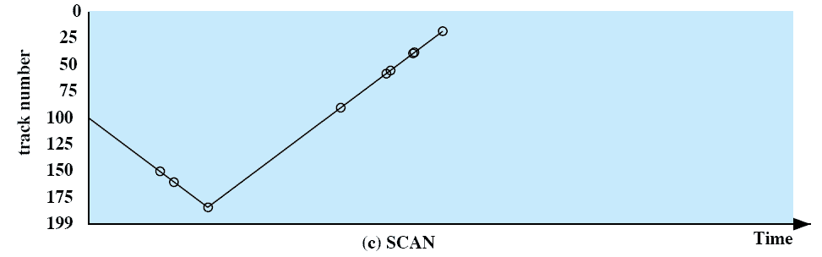
SCAN
Arm moves in one direction only, satisfying all outstanding requests until it reaches the last track in that direction then the direction is reversed
Notes:
With SCAN, the arm is required to move in one direction only, satisfying all outstanding requests en route, until it reaches the last track in that direction or until there are no more requests in that direction.
The service direction is then reversed and the scan proceeds in the opposite direction, again picking up all requests in order.
This latter refinement is sometimes referred to as the LOOK policy.
The SCAN policy favors jobs whose requests are for tracks nearest to both innermost and outermost tracks and favors the latest-arriving jobs.

Slide 96
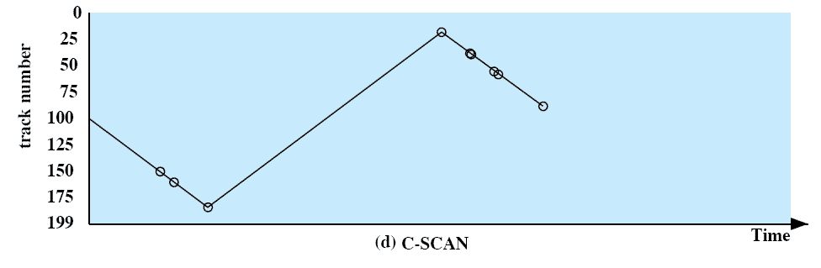
C-SCAN
Restricts scanning to one direction only
When the last track has been visited in one direction, the arm is returned to the opposite end of the disk and the scan begins again
Notes:
The C-SCAN (circular SCAN) policy restricts scanning to one direction only.
Thus, when the last track has been visited in one direction, the arm is returned to the opposite end of the disk and the scan begins again.
This reduces the maximum delay experienced by new requests.

Slide 97
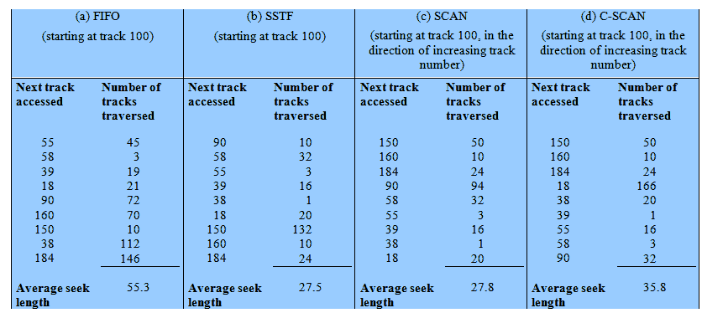
Disk Scheduling Algorithms

Slide 98
Selecting a Disk-Scheduling Algorithm
SSTF is common
SCAN and C-SCAN perform better for systems that place a heavy load on the disk.
Performance depends on the number and types of requests.
Requests for disk service can be influenced by the file-allocation method.
The disk-scheduling algorithm should be written as a separate module of the operating system, allowing it to be replaced with a different algorithm if necessary.
Either SSTF or SCAN is a reasonable choice for the default algorithm.

Slide 99
Suppose the order of request is- (82,170,43,140,24,16,190)
And current position of Read/Write head is : 50
87, 160, 40, 140, 36, 72, 66, 15
In that order, if the disk head is initially at cylinder 60.

Slide 100
FCFS
(60 - 87)+(87 - 160)+(160 - 40)+(40 - 140)+(140 - 36)+(36 - 72)+(72 - 66)+(66 - 15)
= (27+73+120+100+104+36+6+51)
= 517 cylinders
∴ The average head movements are= 517/8 = 64.625 cylinders

Slide 101
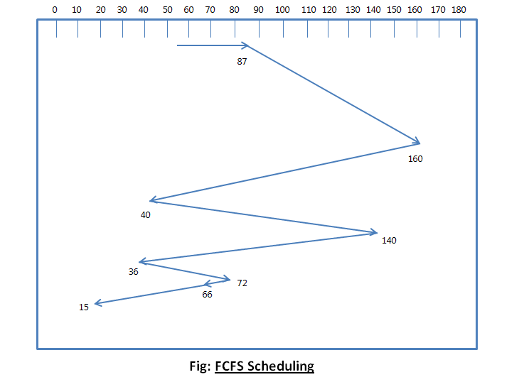

Slide 102
SSTF
The total head movements of this algorithm is
=(60 - 66)+(66 - 72)+(72 - 87)+(87 - 40)+(40 - 36)+(36 - 15)+(15 - 140)+(140 - 160)
= (6+6+15+47+4+21+125+20)
= 244 cylinders
∴ The average head movements are = 244/8 = 30.s5 cylinders

Slide 103
SCAN
The total head movements of this algorithm is
=(60 - 66)+(66 - 72)+(72 - 87)+(87 - 140)+(140 - 160)+(160-199) 199-15
= (6+6+15+53+20+39)
= 323 cylinders
∴ The average head movements are = 323/8 = 40.375 cylinders

Slide 104

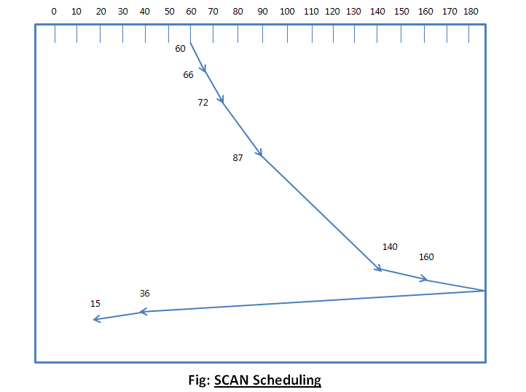
SCAN

Slide 105
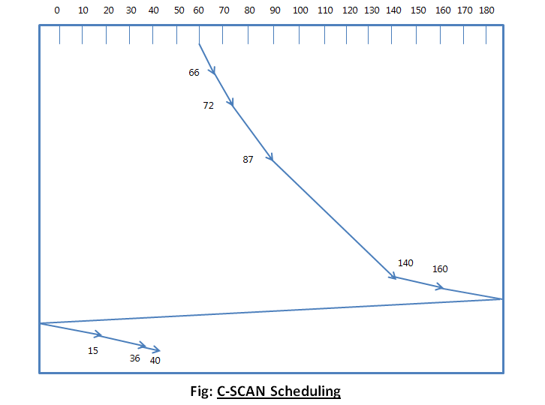
C SCAN
378

Slide 106
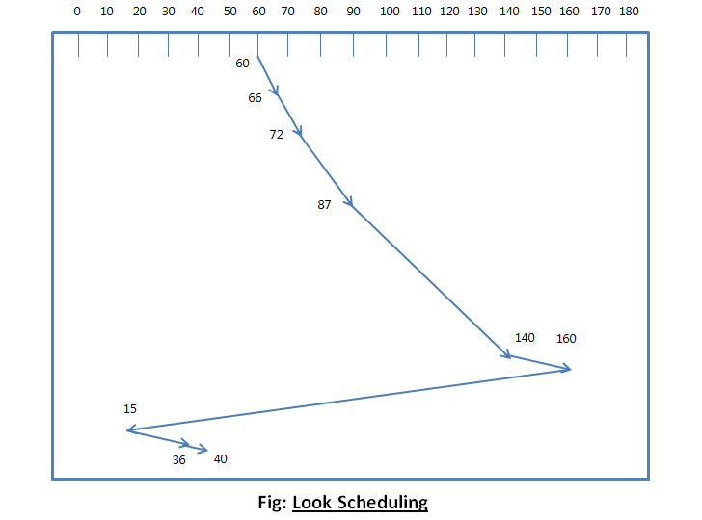
C LOOK
C look 270
Look 245

